Slide 1
One-to-one biases in a non-linguistic and non-communicative domain: 30-month-olds map novel animal vocalizations to unfamiliar animals
Ricardo A.H. Bion, Kyle MacDonald, Anne Fernald

Slide 2
Recent research on disambiguation
Role of experience
Byers-Heinlein & Werker; Fernald - SRCD 2011
Relation to word learning
Horst, Samuelson, McMurray; Bion, Borovsky, & Fernald - SRCD 2011
Domain-specificity
Samuelson; Halberda; Bion et al.; Suanda & Namy - SRCD 2013
Notes:
During the last 35 years, studies have shown that children who are two years of age and older tend to select a novel object as the referent for a novel word
This disambiguation bias is often characterized as a lexical-specific constraint that is universal and fundamental for early word learning.
But studies in recent years started to problematize this characterization:
These studies focused on the role of experience and showed that this affect is not robust across populations
They focused on the relation between disambiguation and word learning, and showed that successful disambiguation does not necessarily lead to retention of the link between a novel word and a novel object
And in this symposium we are focusing on the domain-specificity of this bias

Slide 3
Why do children chose a novel object when hearing a novel word?
Lexical-specific constraints
de Marchena et al., 2011
Inferences about speakers' communicative intentions
Bloom, 2002; Diesendruck & Markson, 2001
Domain-general learning principles
McMurray et al., 2011
Notes:
Debates about the scope of disambiguation biases are not knew, and in very simple terms, there are three main explanations for why children chose a novel object when hearing a novel word
The first is that this bias in referent selection is motivated by lexical-specific constraints or principles
The second is that it is motivated by pragmatic inferences about speakers’ communicative intentions
Most of the debate so far focused on the contrast between lexical specific constraints and pragmatic inferences, showing disambiguation for novel words and facts.
But more recent computational approaches suggest that disambiguation biases might be the result of domain-general learning mechanisms that favors simpler hypotheses in complex learning tasks
One of the challenges in experimentally exploring the strengths of this domain-general account is that it is hard to come up with stimuli that are similar to speech, familiar to young children, and that are meaningfully associated to common objects in children's environments.

Slide 4
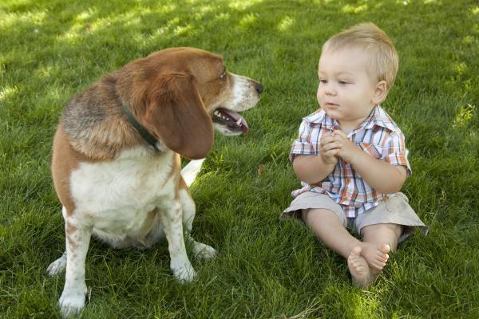
arbitrary
non-arbitrary
animal names
animal vocalizations
Woof!
where's the dog?
Notes:
In trying to come up with this non-linguistic speech analogue, we thought about the vocalizations that animals produce
Animal names and animal vocalizations differ in arbitrariness but they provide consistent meaningful associations between sounds and common objects in children’s environments
In a context like this, the child might learn that this animal is called dog
But the child might learn that dogs bark, creating a link between dogs and their typical vocalization

Slide 5
arbitrary
non-arbitrary
animal names
onomatopoeic words
animal vocalizations
look at the
bow-wow!
Woof!
where's the dog?
Notes:
And these different sounds could actually be characterized within a continuum going from highly arbitrary t non arbitrary.
And a question that we might as is whether children could rely on these three different sounds to recognize a familiar animal.
And whether one of these cues would be particularly powerful in guiding children's attention to familiar animals in their environment.

Slide 6

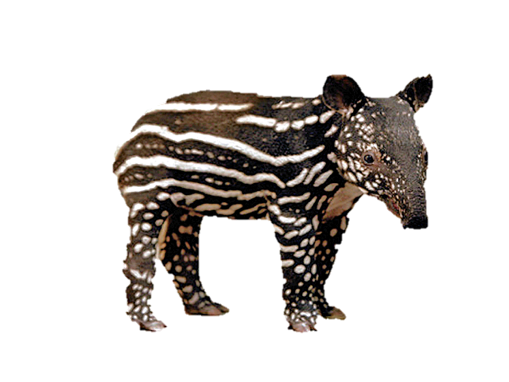
arbitrary
non-arbitrary
novel animal name
novel animal vocalization
novel vocalization
where's the nado?
Notes:
But more importantly, if this dog was paired with a novel animal, would children chose the novel animal when hearing a novel vocalization?
We expect from previous studies that if children heard a novel word like nado, in the presence of a familiar and a novel animal, that they would chose the novel animal as the most likely referent for this word.
The question that we ask is whether children would also look at this animal if they heard a novel animal vocalization like this one… or this one…
And would they later remember that this is the sound that this novel animal makes?

Slide 7
STUDY 1
How quickly can 30-mo-olds use linguistic and non-linguistic cues to identify a familiar animal?
Do children choose a novel animal in response to a novel animal vocalization?
STUDY 2
If so, do children actually remember the mapping between the novel animal and vocalization?
Notes:
Formalizing these general questions, this study addresses three questions, the first is about the processing, the second is about disambiguation, and the third is about retention.
Study 1 asks how quickly 30 month olds can use linguistic and nonlinguistic cues to identify a familiar animal, and also whether children would chose a novel animal in response to a novel animal vocalization, as they do for novel words and objects.
In other words, would children show a disambiguation bias for novel animal vocalizations, as they do for words. That is, would they show disambiguation biases in a non-linguistic and non-communicative domain.
Study 2 focuses on the relation between disambiguation and retention, asking whether children would actually remember the mapping between a novel animal and a novel vocalization created through a disambiguation strategy

Slide 8
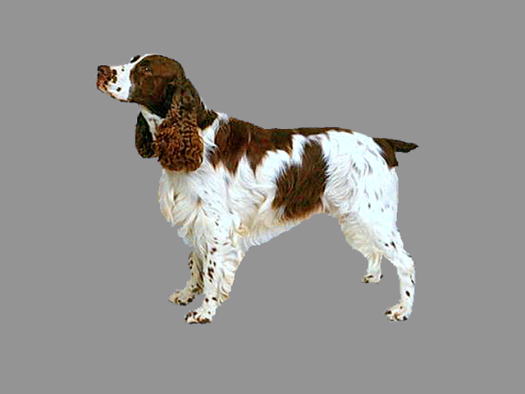
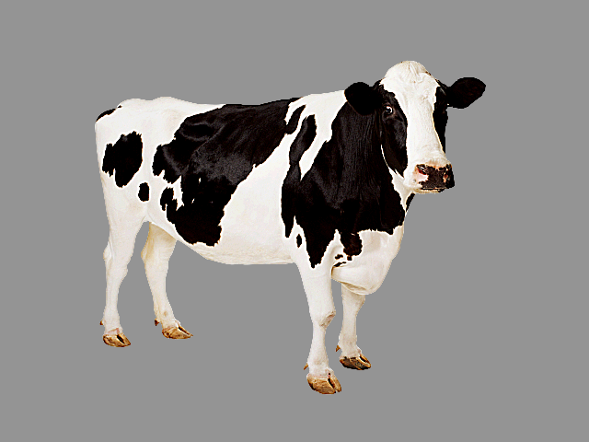
STIMULI: Familiar-sound trials
Where’s the dog?
8 animal-name trials
Which one goes woof-woof?
8 onomatopoeic-word trials
Listen [dog barking]
16 animal-vocalization trials
horse-dog-cow-sheep
30-month-olds (n=21)
Notes:
In study 1, we tested 21 30-month-olds, in two different trial type.
In familiar-sound trials, children saw two familiar animals or a familiar and a novel animal, and they heard a familiar sound.
This sound could be a familiar animal name, as done many studies looking at children's processing of familiar words.
But this sound could also be a familiar onomatopoeic word.
Or a familiar animal vocalization, like the sound of a cow mooing or the sound of a dog barking.
This trial type is relevant because it allows us to make sure that these three very different cues could be used by children to identify a familiar animal.
And it also allows us to investigate whether any of these sound would be particularly effective in guiding children's attention to an animal in children's environment.
In order to make sure that children were familiar with the onomatopoeic sound and with the animal vocalization, we send

Slide 9
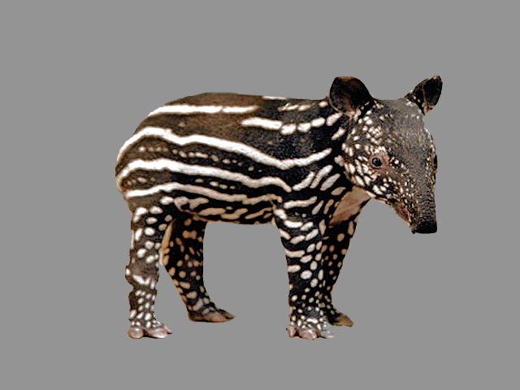
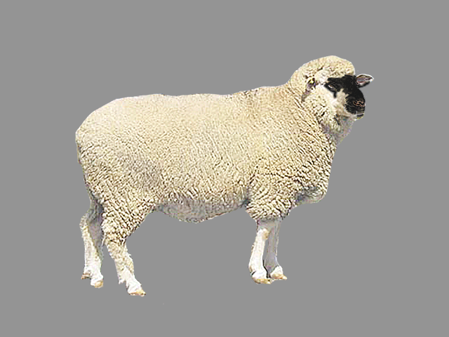
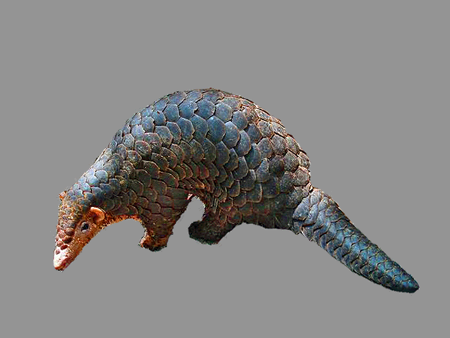
STIMULI: Disambiguation trials
Where’s the nadu?
6 animal-name trials
Listen [novel vocalization]
8 animal-vocalization trials
Novel animals: tapir and pangolin
Novel vocalizations: rhino grunting and gorilla snorting
Notes:
In disambiguation trials, children saw a familiar and a novel animal and heard a novel sound.
One challenge in coming up with these novel animals and vocalizations is that they had to be highly distinct from the familiar animals
and not have clear affordances that would help children disambiguate the novel sound, like big differences in size or animal groups.
We ended up choosing a tapir and a pangolin as our novel animals, and the vocalizations from a rhino and from a gorilla as our novel vocalizations.
And here is a sample of our vocalization:

Slide 10
Measures of processing efficiency
Accuracy:
Proportion looking to the target animal
[300 to 4300 ms]
Reaction time (RT):
Time to shift to the target animal when looking at the distractor animal [300 to 1800]
Notes:
In all trials, we looked at children's accuracy computed over a window from 300 to 4300 ms. This window is a bit longer than typical windows because the animal vocalizations lasted 2 s and we wanted to have the same window length for all trial types.
And reaction time, computed as the time to shift to the target animal when looking at a distractor animal on a window from 300 to 1800 ms.

Slide 11
STUDY 1
How quickly can 30-mo-olds use linguistic and non-linguistic cues to identify a familiar animal?
Do children choose a novel animal in response to a novel animal vocalization?
STUDY 2
If so, do children actually remember the mapping between the novel animal and vocalization?
Notes:
Now let's go directly to our first question.

Slide 12
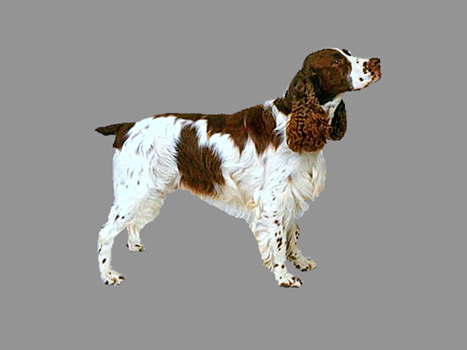
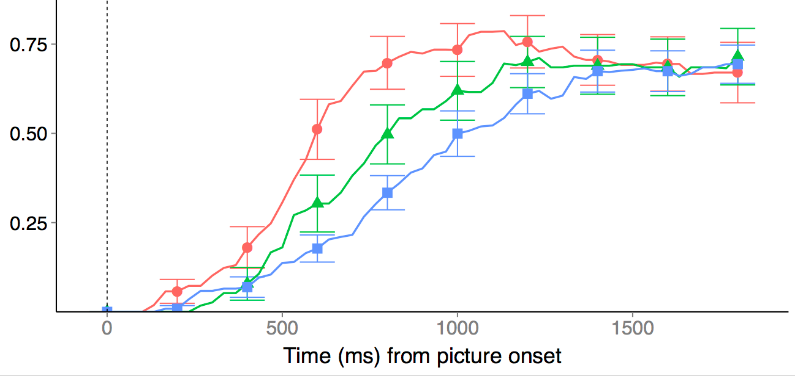
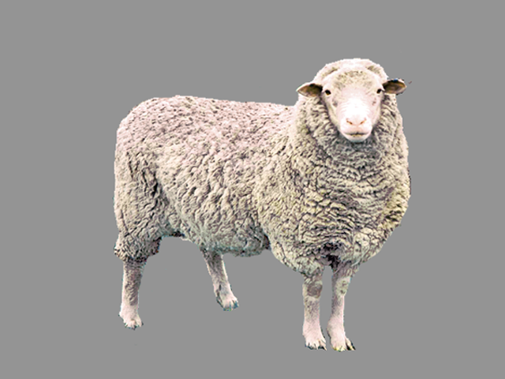
30-mo-olds responded fastest to the familiar animal name and slowest to the familiar animal vocalization
D O G
W O O F
% looking
to target animal
[barking]
animal name (650ms - FAST)
onomatopoeic word (828ms)
animal vocalization (906ms - SLOW)
time (ms) from sound onset
Notes:
These are the results for the familiar-sound trials in which children heard a familiar sound in the presence of two familiar animals or a familiar and a novel animal.
I am showing here children's responses during trials in which they were not looking at the target animal at the onset of the familiar sound.
There are separate lines for children's proportion of looking to the correct animal when they heard an animal name, in red, and onomatopoeic word, in green, and an animal vocalization, in blue
Children were fastest to orient to the target animal in response to the animal name, and slowest in response to the animal vocalization, with onomatopoeic words somewhere in between.

Slide 13
30-mo-olds were fastest to orient to a familiar animal in response to the animal name, and slowest in response to the animal vocalization
D O G
W O O F
Why?
• Frequency
• Signal characteristics
• Representational differences
% looking
to target animal
[barking]
animal name (650ms - FAST)
onomatopoeic word (828ms)
animal vocalization (906ms - SLOW)
time (ms) from sound onset
Notes:
So why?
These differences might be due to massive differences in frequency of exposure between animal names and animal vocalizations
It might be because of differences in frequency: kids have heard the word cow more often than actual cows mooing
It might be due to differences in signal characteristics: words are well designed to convey information
Or they might be due to representational differences e.g. there's a lot of interest in this question, words refer (waxman) they might connect to the lexical system while environmental sounds connect directly to the semantic system (chen and spencer), might be subserved by different brain regions (a lot of brain work)

Slide 14
30-mo-olds were fastest to orient to a familiar animal in response to the animal name, and slowest in response to the animal vocalization
D O G
W O O F
% looking
to target animal
[barking]
animal name (650ms - FAST)
onomatopoeic word (828ms)
animal vocalization (906ms - SLOW)
time (ms) from sound onset
Notes:
Just to review, when we look at children's responses on a window from 300 to 1800 ms we found an advantage for speech over other meaningful sounds.
But as you can see, by 1500ms, there is no longer a difference between the three conditions.
And if we look for accuracy over a much longer window.

Slide 15
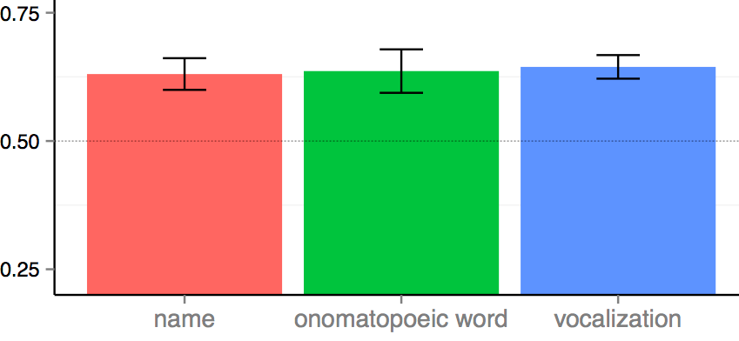
But they all get the job done!
% looking at correct animal
Notes:
All the three different sounds get the job done.
What I am showing here now is children's accuracy.
Children looked at the correct animal reliably above chance when hearing the animal name, an onomatopoeic word, and an animal vocalization, with accuracy indistinguishable across conditions.
And relevant to claims to one-to-one mappings, by the age of 2,5 they children were perfectly fine looking at the picture of a dog when hearing three different sounds

Slide 16
STUDY 1
How quickly can 30-mo-olds use linguistic and non-linguistic cues to identify a familiar animal?
Do children choose a novel animal in response to a novel animal vocalization?
STUDY 2
If so, do children actually remember the mapping between the novel animal and vocalization?
Notes:
While our first question focused on the processing of familiar sounds, our second question focuses on the domain-generality of disambiguation biases. We asked whether children would map a novel animal vocalization to a novel animal. That is, if they would show disambiguation biases in a non-linguistic and non-communicative domain.

Slide 17
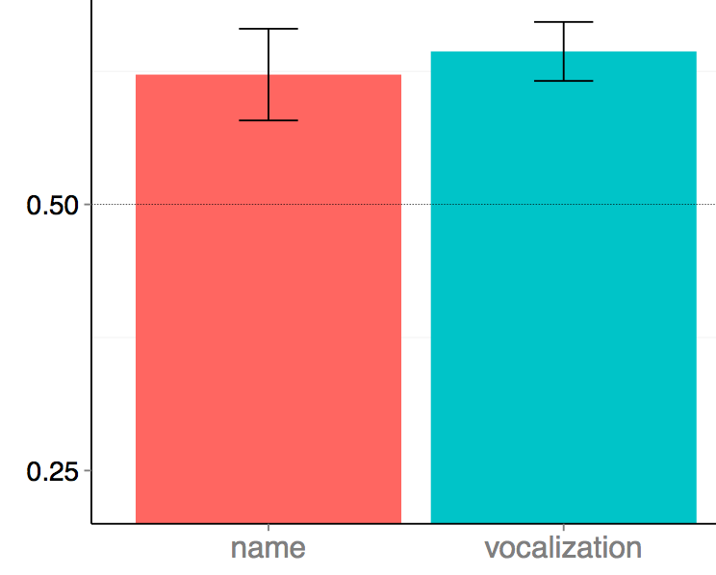
Children chose the novel animal when hearing a novel animal name OR a novel vocalization
% looking at novel animal
Novel
name
Novel
vocalization
Notes:
I am showing here children's proportion looking to the novel animal in the trials in which they heard a novel sound in the presence of a familiar and a novel animal.
As you can see, children reliably looked at the novel animal when hearing the novel name and the novel animal vocalization, with accuracy and RT indistinguishable across conditions.
When the sounds was familiar, differences, but here none.

Slide 18
When a novel animal was paired with a familiar animal, children were above chance in choosing the novel animal in response to a novel animal name or vocalization
• Favor domain-generality
• First demonstration in a non-communicative domain
% looking at novel animal
Novel
name
Novel
vocalization
No differences in accuracy and RT between conditions
Notes:
Our results cannot be easily explained by pragmatic or lexical-constraints accounts, and they seem to favor a domain-general learning mechanism that seeks simple regularities in complex learning tasks
Justin showed us that children have disambiguation biases for voices, Disendruck and Markson showed disambiguation baises for facts, but this is the first demonstration that young children show disambiguation biases in a domain other than speech.

Slide 19
STUDY 1
How quickly can 30-mo-olds use linguistic and non-linguistic cues to identify a familiar animal?
Do children choose a novel animal in response to a novel animal vocalization?
STUDY 2
If so, do children actually remember the mapping between the novel animal and vocalization?
Notes:
In STUDY 1, we showed that children show disambiguation biases for words and for novel animal vocalization.
But it is not clear whether children could use this strategy to learn about novel vocalizations in their environment.
Some recent studies and computational models emphasized that referent-selection is related – but should not be conflated with learning
So study 2, we focus exclusively on novel animal vocalizations, asking whether children would actually remember the mapping between a novel animal and vocalization.

Slide 20
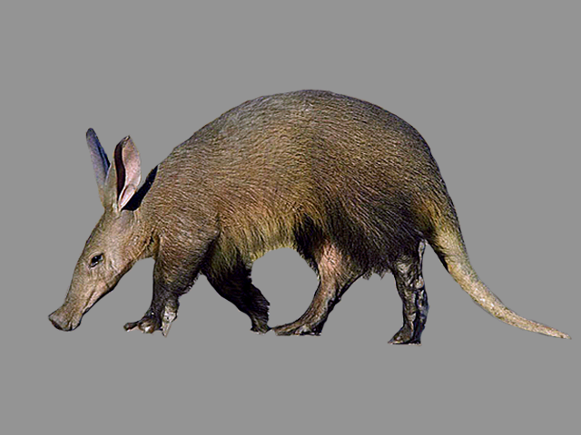
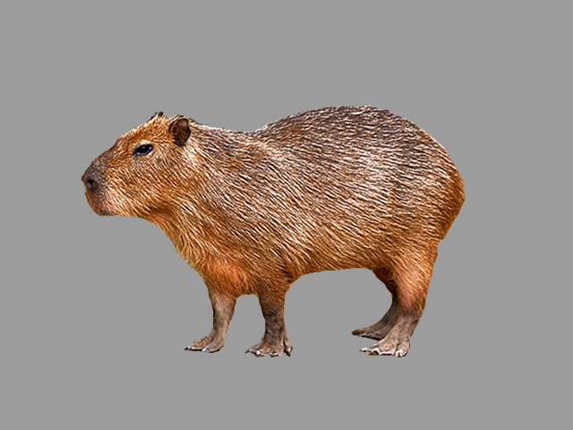
30-month-olds (n = 20) in Familiar, Disambiguation, and Retention trials - same design as Bion, Borovsky, & Fernald (2012)
16 Familiar-vocalization trials
(e.g., barking)
8 Disambiguation trials
8 Retention trials
aardvark - capybara
New animals and focus exclusively on animal vocalizations
Notes:
In STUDY 2 we focus only on novel animal vocalizations, using the same design from a recent study looking at disambiguation biases in the linguistic domain.
In order to make sure that our results in Study 1 were not due to the nature of our stimuli, we chose two different novel animals, an aardvark and a capybara.
We had three different trial types.
In Familiar-vocalization trials, children saw two familiar animals or a familiar and a novel animal and they heard a familiar animal vocalization.
In disambiguation trials, children saw a familiar and a novel animal and heard a novel animal vocalization.
And in retention trials, children saw the two novel animals they learn about through the disambiguation trials.

Slide 21
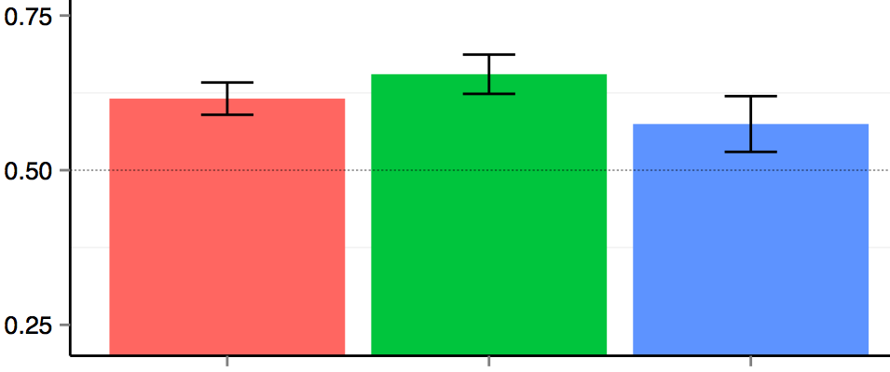
Children reliably chose the novel animal in response to the novel animal vocalization, but showed fragile evidence of remembering this mapping on retention trials
% looking
to target
animal
Familiar
Disambiguation
Retention
Notes:
I am showing here accuracy for these three different conditions. AS in Study 1, children reliably chose a familiar animal in response to a familiar sound, they chose a novel animal in response to a novel animal vocalization, but they showed only fragile evidence of retention.

Slide 22
Children who are better at disambiguating the novel animal vocalizations were better at retention
r (18) = 0.44, p = 0.05
Mean accuracy on
Retention trials
Mean accuracy on Disambiguation trials
Notes:
But as we found in our 2012 paper, there was a relationship between children's disambiguation and retention. Children who were better at determining the referent for a novel word were also better at remembering this link. But as you can see here, basically everyone was above chance on disambiguation, but that does not necessarily resulted in retention.

Slide 23
Children who are better at disambiguating the novel animal vocalizations were better at retention
r (18) = 0.44, p = 0.05
• Disambiguation and retention are related, but they should not be conflated
Mean accuracy on
Retention trials
Mean accuracy on Disambiguation trials
Notes:
This means that disambiguation biases and retention are related, but they should not be conflated.

Slide 24
30-mo-olds were fastest to orient to a familiar animal in response to the animal name
But they also oriented to a familiar animal when hearing a familiar onomatopoeic word or animal vocalization
Disambiguation biases are not restricted to the linguistic domain and they do not necessarily lead to learning
Notes:
30-mo-olds were fastest to orient to a familiar animal in response to the animal name
But they also oriented to a familiar animal when hearing a familiar onomatopoeic word or animal vocalization
As for disambiguation and learning, these findings add to a recent body of research suggesting that
disambiguation biases are not restricted to the linguistic domain and they do not necessarily lead to learning
What does this tell us about this word learning bias.
Mention our low-SES bias.

Slide 25
Recent research on disambiguation
Role of experience
Byers-Heinlein & Werker; Fernald - SRCD 2011
Relation to word learning
Horst, Samuelson, McMurray; Bion, Borovsky, & Fernald - SRCD 2011
Domain-specificity
Samuelson; Halberda; Bion et al.; Suanda & Namy - SRCD 2013
Notes:
This study together with a recent body of work encourages us to think differently about disambiguation biases.
Recent studies started to pay attention to the role of experience on the development of ME. Krista-Byers Heinlein found that young bilinguals do not show evidence of disambiguation biases, anne fernald and adriana weisleder found that amount of speech from caregivers can predict the emergence of disambiguation biases.
In relation to word learning Bob McMurray and Larissa samuelson have done a lot of computational and experimental work showing a dissociation between referent selection and word learning.
And this symposium suggests that disambiguation biases could be explained by a domain-general mechanism that looks for regularities in complex learning tasks in which consistent mappings are observed.
These experiments show intriguing parallels between children's identification of objects across seemingly different domains. Instead of categorically showing that linguistic and non-linguistic learning is subserved by the same strategies and mechanisms, I hope this study motivates more work on how children can use their current knowledge to learn new information in linguistic and nonlinguistic domains.

Slide 26
Recent research on disambiguation
Disambiguation is a word learning strategy motivated by a universal lexical constraint
vs.
Disambiguation is the result of a domain-general mechanism that builds on early experience and does not necessarily lead to learning
Notes:
And I want to end with two very different characterizations of disambiguation biases.
One assumption that has been challenged already, is that disambiguation is a
But the findings from recent studies seem to suggest instead that

